Slide 1
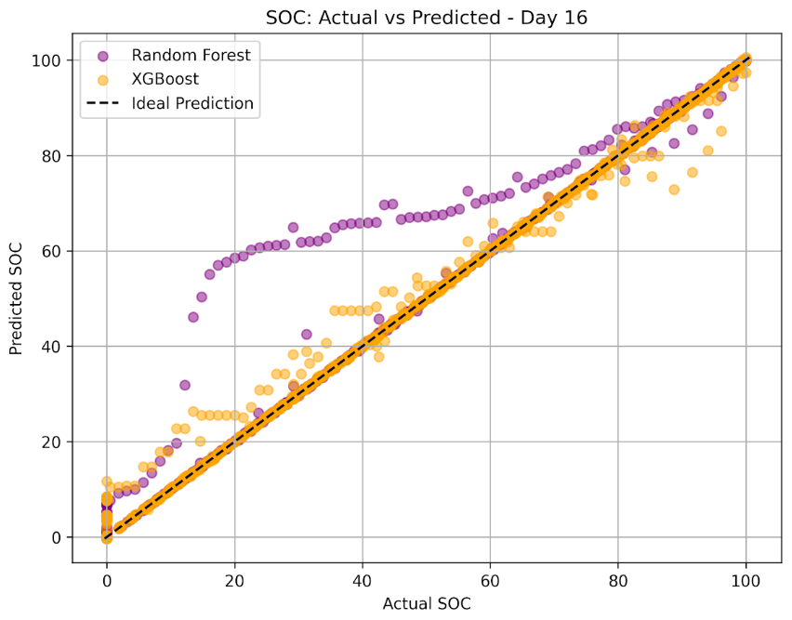
MODEL ANALYSIS AND PERFORMANCE INSIGHTS
NAME:- SREEJA SANYAL
WEEK :-3
DAY:-18
DATE:- 16.09.2026

Slide 2
MODEL / METHOD COMPARISON
Comparison of Machine Learning Models for SOC and Remaining Charging Time Prediction:-
Model | SOC MAE | SOC RMSE | Remaining Time RMSE | Remaining Time R² | Remaining Time MAE | SOC R²
Linear Regression | 4.681095 | 11.754876 | 12224.276890 | 0.709272 | 8817.875379 | 0.918719
Random Forest | 0.623971 | 3.769013 | 761.562992 | 0.998872 | 481.613841 | 0.991644
XGBoost | 0.500706 | 1.690871 | 1223.355192 | 0.997088 | 606.707679 | 0.998318
MLP | 2.628960 | 3.993360 | 1003.307039 | 0.998042 | 713.387572 | 0.990619

Slide 3
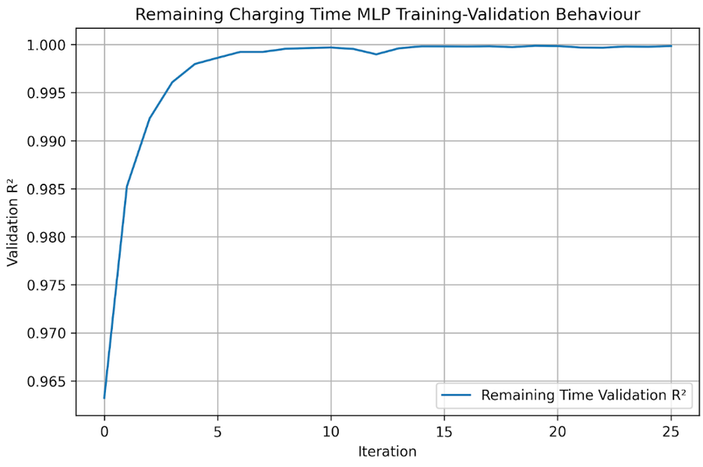
ANALYSIS OF MODEL BEHAVIOUR
1.
Overfitting Check:-
  Training and validation performance were compared.
  SOC models showed a noticeable train–validation performance gap.
  Hyperparameter tuning reduced model complexity and improved validation behaviour.
  Remaining Charging Time models showed comparatively strong validation performance.
2.
Data Limitations:-
  Performance depends on the available battery operating conditions.
  Battery temperature and charging behaviour may vary across experiments.
  Some operating conditions may have fewer observations than others.
  The dataset may not represent every real-world charging condition.

Slide 4
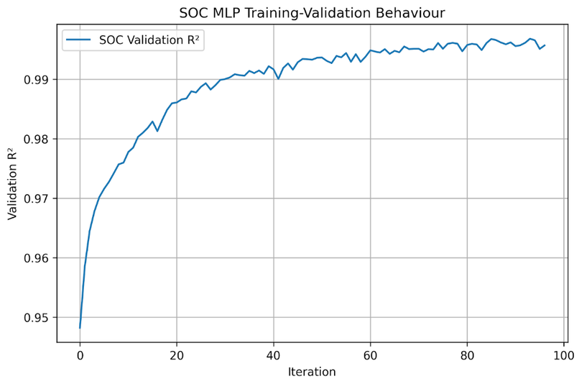
3.
Model Complexity:-
  Linear Regression: simple and interpretable baseline.
  Random Forest: captures nonlinear relationships using multiple decision trees.
  XGBoost: boosted tree model with stronger control of model complexity.
  ANN/MLP: capable of learning nonlinear patterns but requires more training and tuning.
4.
Observed Error Patterns:-
  Prediction errors are not necessarily uniform across the complete charging process.
  Errors may increase in difficult SOC regions or under changing charging conditions.
  Remaining Charging Time can be affected by changes in charging behaviour.
  Error analysis will be investigated further in Day 20.

Slide 5
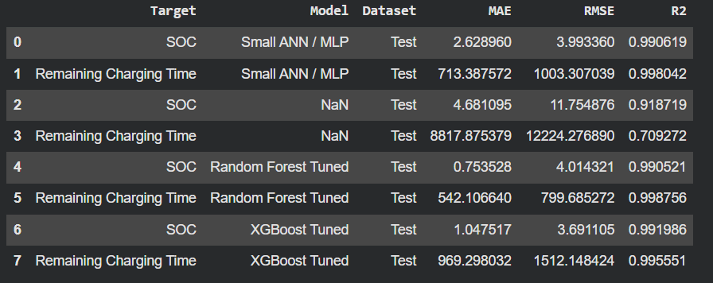
MODELS SELECTED FOR FURTHER EXPERIMENTS
SOC Prediction:-
  XGBoost
  Random Forest
Remaining Charging Time Prediction:-
  Random Forest
  XGBoost
Reference Baseline:-
  Linear Regression
ANN/MLP:-
  Retained as an additional neural-network comparison model.
Selection Criteria
  Validation MAE
  Validation RMSE
  Validation R²
  Generalization gap between training and validation
  Model complexity and computational requirements

Slide 6
CONCLUSION
The model comparison helped identify suitable candidate methods for further investigation based on validation performance, generalization behaviour, error patterns, and model complexity.
THANK YOU !

